Slide 1
Lesson 4.1
Introduction to Node.js

Slide 2
Learning Outcomes
Define Node.js, know how it works, explain its advantages and disadvantages
Open Node.js terminal do basic operations
Differentiate Node core modules, local modules, and third-party modules
Identify the syntax and methods to use built-in or core Node.js modules

Slide 3
What is Node.js?
Open-source server-side runtime environment.
Runs on Google Chrome’s V8 JavaScript engine.
Provides an event driven, non-blocking I/O and cross-platform runtime environment for building server-side applications using JavaScript.
Can build different types of applications:
Command line applications
Web applications
Real-time chat applications
REST API server

Slide 4
Advantages of using Node.js
Open-source and free.
Uses JavaScript to build the entire server-side application.
Using JavaScript to build both the client-side and server-side removes the need to “context switch”.
Client-side JavaScript makes heavy use of the DOM with no access to files/databases.
Server-side JavaScript deals mostly in files/databases, with no access to the DOM
Lightweight framework the includes the bare minimum modules. Other modules can be added as-needed.
Asynchronous by default.
Cross-platform framework that works on Windows, Mac, and Linux.
Node.js is “event” based, while most web servers are thread based.

Slide 5
What’s different with Node.js?
Node.js is a platform for writing JavaScript applications outside web browsers.
This is not the JavaScript you are familiar with in web browsers.
There is no DOM built into Node.js, nor any other browser capability.
Node.js runs on a terminal.

Slide 6
Process Model
A common task for a web server can be to open a file on the server and return the content to the client.
Traditional web server method:
Sends the task to the computer's file system.
Waits while the file system opens and reads the file.
Returns the content to the client.
Ready to handle the next request.
Node.js method:
Sends the task to the computer's file system.
Ready to handle the next request.
When the file system has opened and read the file, the server returns the content to the client.
Node.js eliminates the waiting, and simply continues with the next request.

Slide 7
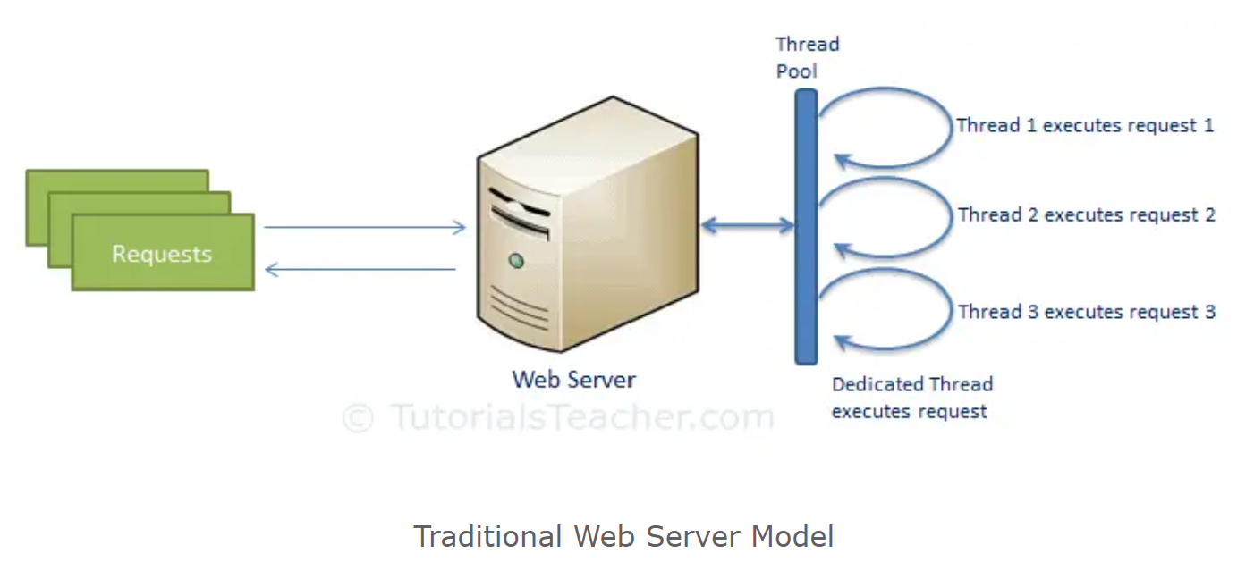
Process Model
Traditional web server model:
Each request is handled by a dedicated thread from the thread pool.
If no thread is available, then the request waits until one completes the execution and returns a response.

Slide 8
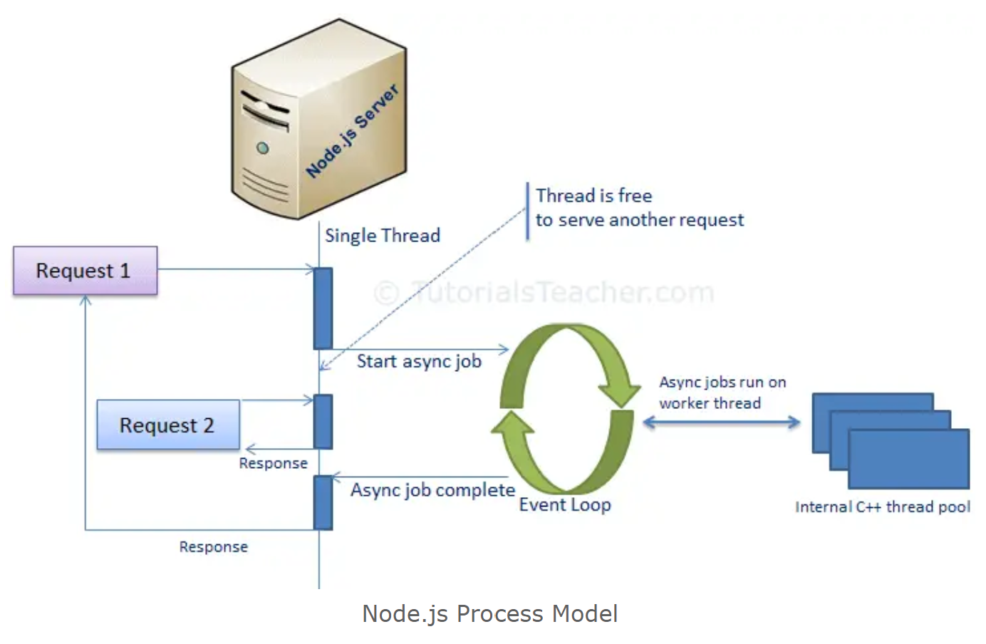
Process Model
Node.js web server model:
The application code runs in a single thread and thereby needs less resources than other platforms.
All requests are handled by a single thread and performed asynchronously.
The single thread doesn't have to wait for the request to complete and is free to handle the next request.
When asynchronous work completes then it processes the request further and sends the response.
An event loop is constantly watching for the events to be raised for an asynchronous job and executing callback functions when the job completes.

Slide 9
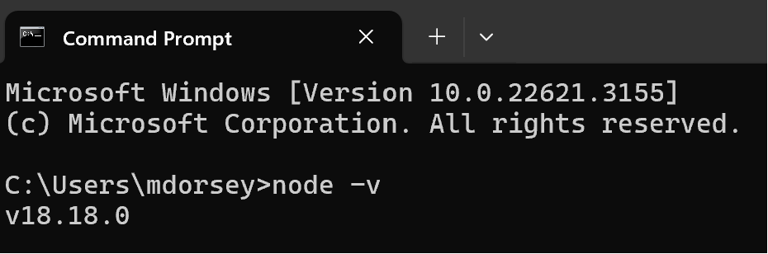
How to setup Node.js
Requirements:
Install Node.js: https://nodejs.org/en
Install the Node Package Manager (npm)
Comes included in the Node.js installer.
Integrated development environment or text editor (e.g. Visual Studio Code)
After installing, open a command prompt and type “node –v”. It should display the current version of node installed.

Slide 10
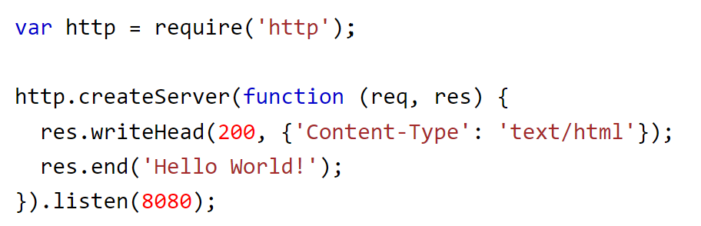
How to run Node.js files
Node.js files must be initiated using the command line interface of your computer.
Example:
Create a JavaScript file called “myserver.js” and save it somewhere on your computer.
Enter the following code into that file. It tells the computer to write "Hello World!" if a web browser tries to access your computer on port 8080.
Open a command prompt and navigate to the folder that contains the file.
Enter the command “node myserver.js”. This initiates the file.
Open a browser and go to http://localhost:8080/

Slide 11
Node.js Modules
Node modules are like JavaScript libraries. Modules are a set of functions you want to include in your application.
Each module in Node.js has its own context, so it cannot interfere with other modules or pollute global scope.
Node.js includes three types of modules:
Core Modules (e.g. http, path, fs).
Local Modules - modules created locally in your Node.js application. These modules include different functionalities of your application in separate files and folders.
Third Party Modules.

Slide 12
Node.js Modules
To use a module, use the require() function along with the name of the module.

Slide 13
Core Modules: HTTP
The HTTP module allows Node.js to transfer data over the Hyper Text Transfer Protocol (HTTP).
Using the HTTP module, your application can create a server that listens to server ports and gives a response back to the client. Use the createServer() method to do this.
The createServer() method has a callback function parameter, and that callback function has request (“req”) and response (“res”) parameters.
“req” represents the request object coming from the client.
“res” represents the response object to send back to the client.
You can do many things with the request and response parameters.

Slide 14
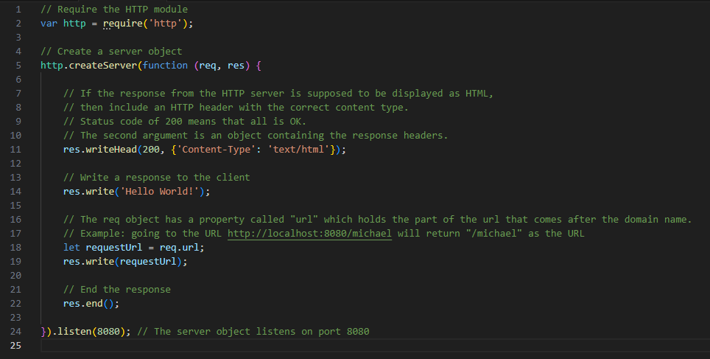

Slide 15

Core Modules: File System (fs)
The Node.js File System module allows you to work with the file system on your computer. It is responsible for all the asynchronous or synchronous file I/O operations.
Common uses for the file system module:
Read files
Create files
Update files
Delete files
Rename files
To include the File System module, use the require() method:

Slide 16
Core Modules: File System (fs)
Here is a list of common and useful methods available through the File System module.
Reading files:
fs.readFile()
Creating files:
fs.appendFile()
fs.open()
fs.writeFile()
https://www.w3schools.com/nodejs/nodejs_filesystem.asp
Updating files:
fs.appendFile()
fs.writeFile()
Deleting files:
fs.unlink()
Renaming files:
fs.rename()

Slide 17

Core Modules: Path
The Node.js Path module offers utilities for working with file and directory paths on your computer. It often is used with the File System module.
To include the Path module, use the require() method:
List of available methods: https://www.w3schools.com/nodejs/ref_path.asp

Slide 18
Local Modules
You can create your own modules, and easily include them in your applications.
Use the exports keyword to make properties and methods available outside the module file.

Slide 19
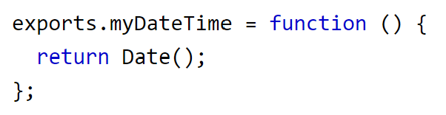
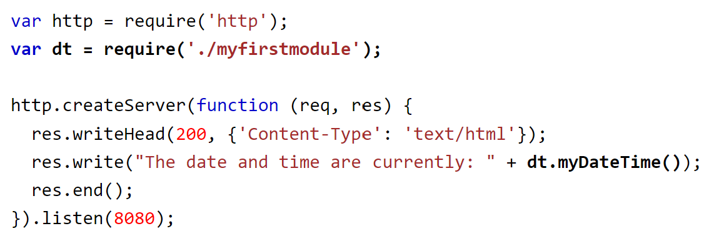
Local Modules
Example:
Create a JavaScript file called “myfirstmodule.js”. Enter the following code into that file. It creates a module that returns a date and time object.
Create a JavaScript file called “clock.js”. Enter the following code into that file. It creates a server that displays the date and time taken from the other local module.
Open a command prompt and navigate to the folder that contains the files. Enter the command “node clock.js”. This initiates the file.
Open a browser and go to http://localhost:8080/

Slide 20
Lesson 4.2
Node.js local module

Slide 21
Learning Outcomes
Differentiate module.export and exports method
Create your own local module and make it exportable
Use both module.export and exports syntax to create local module
Use local and core module using Node.js

Slide 22
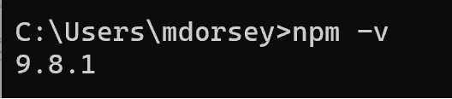
Node Package Manager (npm)
npm is the world's largest software registry
https://www.npmjs.com/
Contains over 1 million code packages.
Open-source developers use it to share software.
Free to use.
You can download all npm public software packages without any registration.
npm is also a command line tool
Used to install, update, and uninstall Node.js packages in your application.
npm is installed with Node.js. Verify it is installed by executing “npm –v” in a command prompt.

Slide 23
Using npm
npm is a software package manager and the default one for Node.js. What does that mean?
Every Node.js application can be scoped as a npm package.
When we want to create a new Node.js project, we use the command “npm init” to initialize the project’s files so that they conform to the npm-standard.
Running npm init will create a special file called package.json.
package.json contains important metadata about your project:
Name: the name of your JavaScript library/project.
Version: the version of your project.
Description: description of the library/project.
License: the project's license.
Main: the name of the file to be called when your application starts (also called the “entry point”).
Usually a file named “app.js” or “index.js”

Slide 24
Using npm
Do the following to create a new Node.js project using npm:
Create a new directory on your computer using the name of your project.
Open a terminal and navigate to that directory.
Type npm init and then press Enter.
The terminal will ask you a series of questions, with suggestions in parenthesis ().
Press Enter to accept the default value or enter new values. Your entries will populate the package.json file.
Upon completion, there will be a new package.json file in your directory that describes the metadata of your project.

Slide 25
Using npm
You can also use npm to install 3rd party modules (hosted online) in your local Node.js project folder.
npm install [package_name]
For example, to install the “express” module you would enter the command “npm install express” from inside your Node.js project’s folder.
All modules installed using npm are installed in a special folder called “node_modules.”
npm also manages dependencies.
Dependencies are the 3rd party modules that your project depends on.
Dependencies are defined in package.json.
Note: using the npm install command will create a new file called package-lock.json. You can safely ignore this file; it is used by node to ensure reproduction of build environments.

Slide 26
Node.js Modules
Node modules are like JavaScript libraries. Modules are a set of functionalities you want to include in your application.
Each module in Node.js has its own context, so it cannot interfere with other modules or pollute global scope.
Node.js includes three types of modules:
Core Modules (e.g. http, path, fs)
Local Modules - modules created locally in your Node.js application. These modules include different functionalities of your application in separate files and folders.
Third Party Modules

Slide 27
Exporting Modules
How do we make modules available to other parts of our application?
“module.exports” is a special object which is included in every JavaScript file in the Node.js application by default. It holds the exported values and functions from that module.
Use module.exports to expose a function, object or variable as a module in Node.js.
module is a variable that represents the current module, exports is an object that will be exposed as a module
So, whatever you assign to module.exports will be exposed as a module. Another module can import it using the require() method.
Note, when using require():
You must specify “./” as a path of the root folder to import a local module.
You do not need to specify the path to import Node.js core modules or NPM modules.

Slide 28
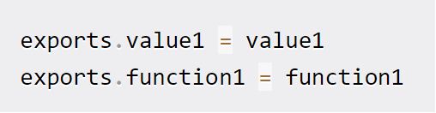

Exporting Modules
You can export functions and values from a module by either using module.exports or just plain exports (exports serves as a reference to module.exports).
Exporting with just the exports keyword is a quick way to export items from a module.
You can use it multiple times throughout a file, and additional uses will add to previous ones.
Exporting with module.exports will explicitly specify a module’s exports.
Use it only once in a file. Using it multiple times will overwrite previous attempts.

Slide 29
Volunteer Registration App
Demo of how to build a volunteer registration system using Node.js and command line inputs.
This program accepts user inputs about volunteers and saves it to a local JSON file.
Download the source files to follow along: D2L > Class Resources > “volunteer_registration_system.zip”.
“app.js” is the program’s main file.
It uses functions stored in the local module “displayFileLocation.js”.

Slide 30
Volunteer Registration App
Problem:
Notice that many functions in app.js are used to get command line inputs from the user. They are making our “app.js” file large.
Can we move those functions to a new file, “getUserData.js”, and then export them as local modules?
Doing this would help us keep our main “app.js” file slim and focused, and make our functions designed to get user inputs available to other parts of our program (if we expand it in the future).
Practice activity!
Move the following functions from “app.js” into “getUserData.js”:
readVolunteerData
promptVolunteerInput
validateVolunteerData
registerMoreVolunteers
Export those functions as local modules from “getUserData.js”.
Import those functions into “app.js”.

Slide 31
Assessments
GLA 2
In-class test on August 6, 8:00am.
75 minutes to answer the given coding tasks.
Worth 10% of your grade.
Covers Module 4.
Open notes, open internet.
No AI tools allowed.

Slide 32
Group Project Check-in
What did your team accomplish since our last check-in?
What will your team accomplish by the next check-in?
If you want to demo your Phase 1 application to me, there are timeslots available for the second half of class on Tuesday, August 6th.
MS Teams > Chat Room > Files > Project Phase 1 demo signup.xlsx
This is OPTIONAL and can be used for getting feedback.

Slide 33
For next class
Prepare for GLA 2.
Second half of class will be open for any groups who want to demo and get feedback on Phase 1 of their project.
Assessments Reminder:
GLA 2 will be an in-class test on August 6, 8:00am.
Assignment 2 due August 20, 8:00am.
Group Project due August 22, 11:59pm.
All assessment dates have been posted in D2L.
See the “Assignments Policy” for late submission procedures.

Slide 34
References
http://net.tutsplus.com/tutorials/javascript-ajax/this-time-youll-learn-node-js/
https://www.tutorialsteacher.com/nodejs/what-is-nodejs
https://www.tutorialsteacher.com/nodejs/nodejs-process-model
https://www.w3schools.com/nodejs/nodejs_intro.asp
https://www.w3schools.com/nodejs/nodejs_modules.asp
https://www.tutorialsteacher.com/nodejs/nodejs-file-system
https://www.w3schools.com/nodejs/nodejs_filesystem.asp
https://www.w3schools.com/nodejs/ref_path.asp
https://www.tutorialsteacher.com/nodejs/nodejs-local-modules
https://www.tutorialsteacher.com/nodejs/nodejs-local-modules
https://www.tutorialsteacher.com/nodejs/nodejs-module-exports
https://www.freecodecamp.org/news/module-exports-how-to-export-in-node-js-and-javascript/
https://www.tutorialsteacher.com/nodejs/what-is-node-package-manager
https://www.w3schools.com/whatis/whatis_npm.asp
https://www.freecodecamp.org/news/what-is-npm-a-node-package-manager-tutorial-for-beginners/

